Slide 1
Using fantasy stats to predict NFL win percentage
Michael Brown
Zack Soden
DATA 606 - Spring 2022

Slide 2
Background
Why fantasy football?
Fun; gives even the most casual fans a reason to have an interest in games
Requires critical thinking skills, often on a daily basis. Team owners are constantly making players moves based on information and research throughout the week

Slide 3
Research questions
We aim to answer:
Do teams with players who accumulate a lot of fantasy points achieve more wins than teams that do not?
Is there a correlation between fantasy points scored and team wins?
Does a particular player position have a stronger correlation to wins?
Use historical data to train a model that predicts team wins based on fantasy points
Compare projected 2020 team win results to actual results

Slide 4
Assumptions
Teams with talented skill position players will have higher fantasy points based off yards and touchdowns. In general, scoring more TD’s should lead to more wins
Fantasy football often comes down to a player’s usage (rushes, catches, pass attempts, etc.) which can fluctuate depending on the flow of the game
Quarterbacks on teams that are losing by 7 or less points in the 4th quarter have double the amount of pass attempts as those on teams who are winning by 7 or less
More pass attempts means more yards and touchdowns (positive gain in fantasy points) but also more interceptions ( negative points)
Player injuries, weather, “momentum” can also affect usage
Notes:
https://dknation.draftkings.com/nfl/2020/6/26/21309173/predicting-game-flow-in-the-nfl

Slide 5
Existing Projects
Kaggle user analyzed 2019 player fantasy points; made predictions on 2020 output. The goal was to determine which players would be underrated or overrated based on projected points and draft the players accordingly. Appears limited as only one year of fantasy data was used
In a capstone project, a Louisiana Tech student used an ARIMA-based model to predict how many fantasy points a player would score in the future. Their model analyzed a player’s 2019 stats to product 2020 performance. Results were pretty accurate according to a MAPE (Mean Absolute Percentage Error) of 4.65%. However, it seems this was treated more as a math problem than a data science project.
Did not find any existing research or projects where fantasy points was used to predict wins or team success, only future fantasy points
Notes:
https://www.kaggle.com/mur418/espn-2019-stats-and-2020-nfl-fantasy-projections
https://digitalcommons.latech.edu/mathematics-senior-capstone-papers/20/
Mean Absolute Percentage Error - commonly used in time series analysis; it is the average of absolute percentage errors. It is a measure of accuracy of a method for constructing fitted time
series values in statistics

Slide 6
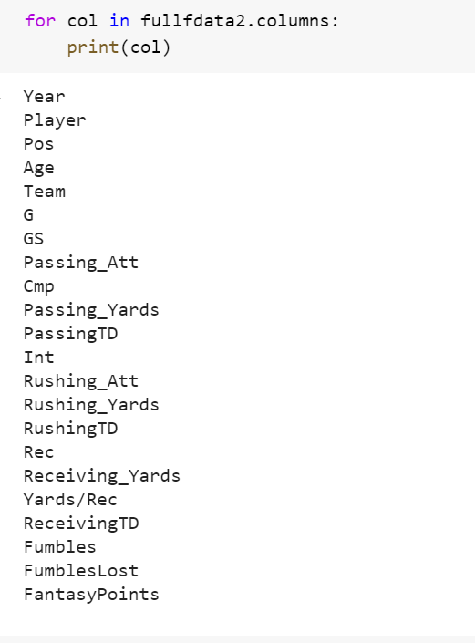
Data
Fantasy data from NFL seasons 1970-2019
Merged 50 separate .csv files into a single dataframe
After cleansing: 23,144 rows × 22 columns
Points are yearly totals
Having team name and position values can allows for more detailed analysis
https://www.fantasyfootballdatapros.com/csv_files
Notes:
Data:
Weekly and Yearly Fantasy point datasets available through 2019 from: https://www.fantasyfootballdatapros.com/csv_files

Slide 7
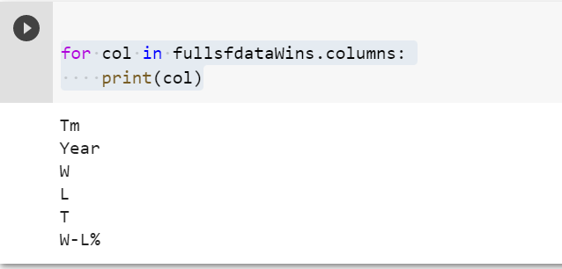
Data (cont.)
NFL Team standings from NFL seasons 1970-2020
Two .xlsx files from each season (one for each conference)
Merged 102 files into a single dataframe
After cleansing: 1477 rows × 6 columns
1970 NFL Standings & Team Stats | Pro-Football-Reference.com
Both AFC and NFC Standings tables

Slide 8
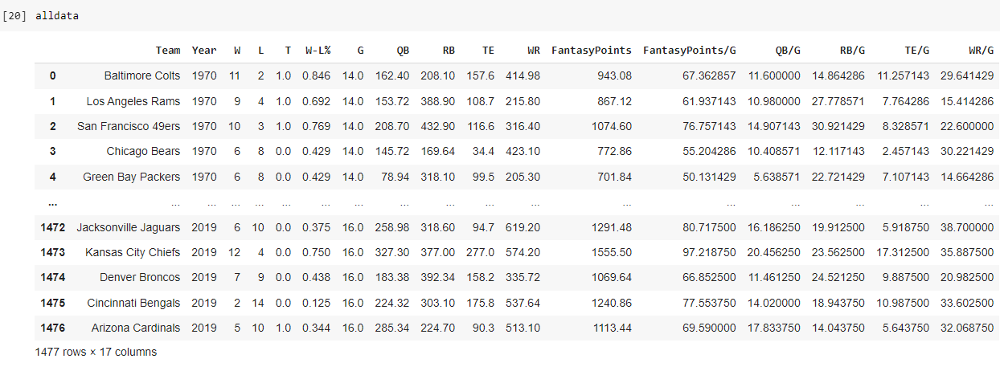
Exploratory Analysis
Finalized Data Set
Merged relevant columns from other data sets
Added columns that show points by position and averages points per game
1477 rows x 17 columns

Slide 9
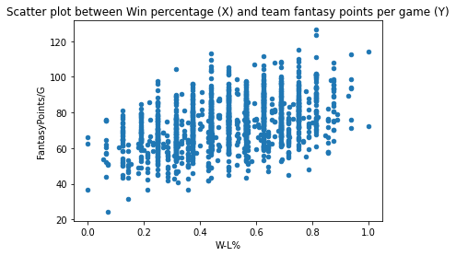
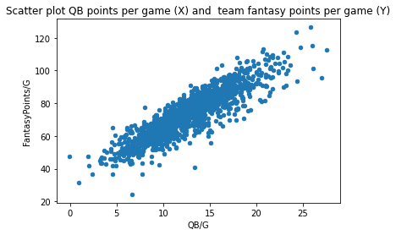
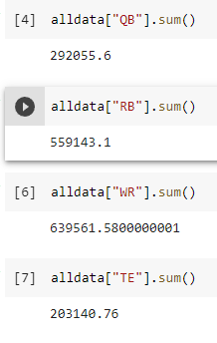
Exploratory Analysis
So far, we are seeing a correlation between points and win percentage
QB and WR points contribute most to total points scored
QB and RB points contribute most to win percentage
WR and RB have the highest percentage of total team points

Slide 10
References
Murphy, C. (2020). ESPN 2019 Stats and 2020 NFL Fantasy Projections. Kaggle.com; Kaggle. https://www.kaggle.com/mur418/espn-2019-stats-and-2020-nfl-fantasy-projections
Predicting Game Flow in the NFL. (2020, June 26). DraftKings Nation; Vox Media, LLC. https://dknation.draftkings.com/nfl/2020/6/26/21309173/predicting-game-flow-in-the-nfl
Robinson, C. (2020). The Prediction of Fantasy Football. Louisiana Tech - Mathematics Senior Capstone Papers. https://digitalcommons.latech.edu/mathematics-senior-capstone-papers/20
Notes:
https://www.kaggle.com/mur418/espn-2019-stats-and-2020-nfl-fantasy-projections
https://digitalcommons.latech.edu/mathematics-senior-capstone-papers/20/
Mean Absolute Percentage Error - commonly used in time series analysis; it is the average of absolute percentage errors. It is a measure of accuracy of a method for constructing fitted time
series values in statistics

